Slide 1
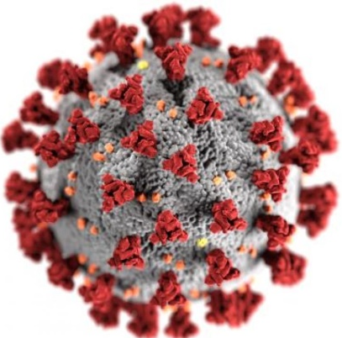
How much do we know about the invisible Enemy?
COVID-19
Dr. Quazi Tarikul Islam
Professor of Medicine
Member, National Technical Advisory Committee on COVID-19
prof.tarik@gmail.com

Slide 2
CASE 1
A 69 year old man had 2 days low grade temperature without cough, sore throat and SOB had severe fatigue only passed 7 days at home.
He was checking saturation at home which remains between 95 – 96% so he did not do any investigations. On 9th day of illness he has been investigated for RT-PCR for COVID came negative. On 10th day CRP, Ferritin, LDH, D-dimer and HRCT Lung. All investigations were very high with HRCT chest shows 60 % of lung infiltrates as GGO and crazy paving.
Contd....

Slide 3
CASE 1
He was treated as COVID pneumonia initialy moderate then severe type. Treated with Enoxaparin, Ramdisivir, Antibiotics, Oxygen therapy and Steroid. Oxygen requirement went up to 10-12 liters which came down to 2 liters /min. Patient also got Inj. Tocilizumab 2 shots in 12 hours apart. All the parameters of tests came down to normal except D-dimer which remains above 1000ng/ml. Lung shadow reduced to 25%.
Contd....

Slide 4
CASE 1
On 28 days of illness (18 days of treatment) he was put on DOAC and supportive drugs as he is hypertensive, Diabetic and history of PCI. 4 days after the oral drugs all investigations repeated lungs had 30-35% basal shadow with fibrotic changes and persistent high D-dimer. All other tests were normal. The patient stated complaining of more oxygen demand. From 2 liter it increases to 6 liters. HRCT chest done and it was a very bad picture involving 70% of lung. IgG titer for COVID was done came good titer positive.
Contd....

Slide 5
CASE 1
Further he was put on therapeutic dose of Enoxaparin, Steroid Antifungal (Voriconazole), Antibiotics, Oxygen upto HFNC 40L/min. Sputum shows profuse growth of Klebsiella Pneum. He was deteriorating and at 92% of saturation he was put on Ventilator on 44th day of illness. Vitals were well maintained.
ANA,ENA profile, Anti Scl 70, Anti CCP ab, RA all were negative. On 50th day of illness lung shadow again improved with 30% shadow at base but total count very high. Presently on ventilator.

Slide 6
CASE 2
A 56 year non diabetic, non hypertensive businesswoman had body ache only on 5th April and did PCR which was positive on 9th April. She was treated symptomatic got well and came back to work after 3 weeks. On 21st May she developed fever, dry cough. On 26th May she got admitted in to hospital and underwent following investigations. CXR, HRCT Lung, CBC,D-dimer, CRP, Ferritin, LDH. All investigations were in favour of COVID so PCR was done and came positive.
Contd....

Slide 7
CASE 2
Enoxaparin, Remdisivir, Steroid, Toclizumab, Oxygen therapy up to HFNC 50L/min failed to improve the clinical situation and was put on Ventilator on 4th June. In 48 hours of mechanical support she developed tachyarrythmia with increased Trop-i level. She developed cardiac arrest twice reversed with cardioversion but third arrest could not be reversed and the patient died.

Slide 8

WE MOURN
Hats Off to The Frontliners

Slide 9
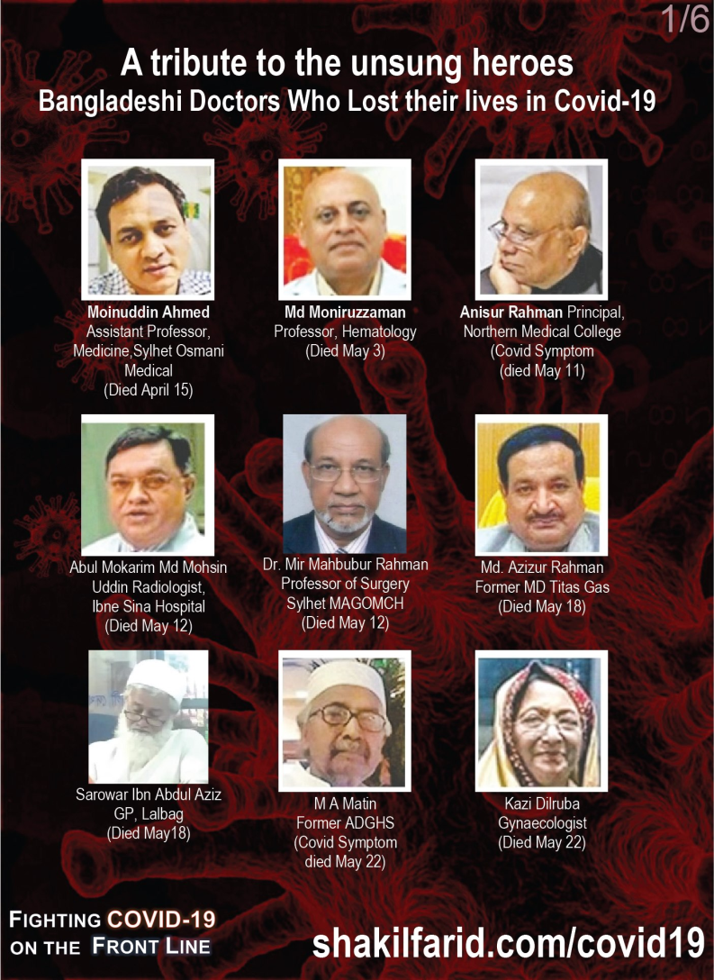
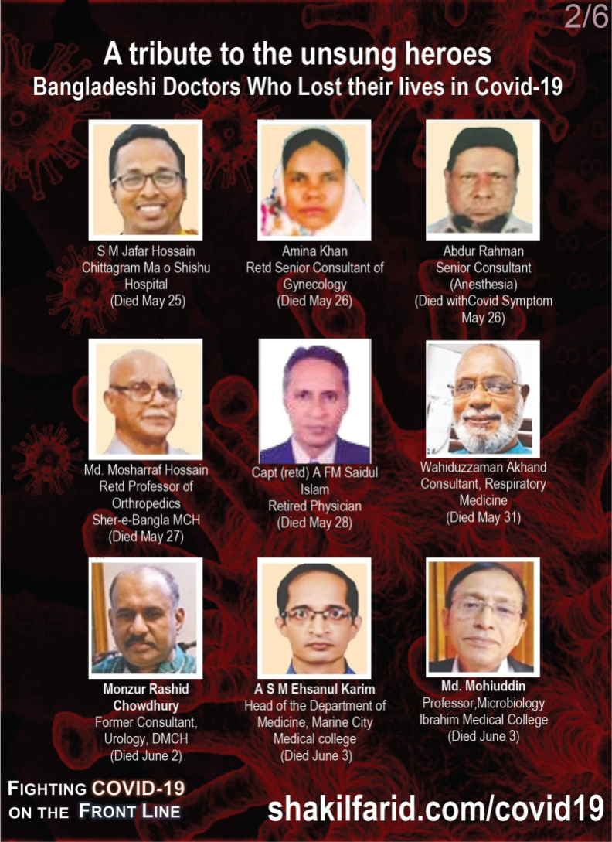
Notes:
Total death of Bangladeshi doctor 56

Slide 10
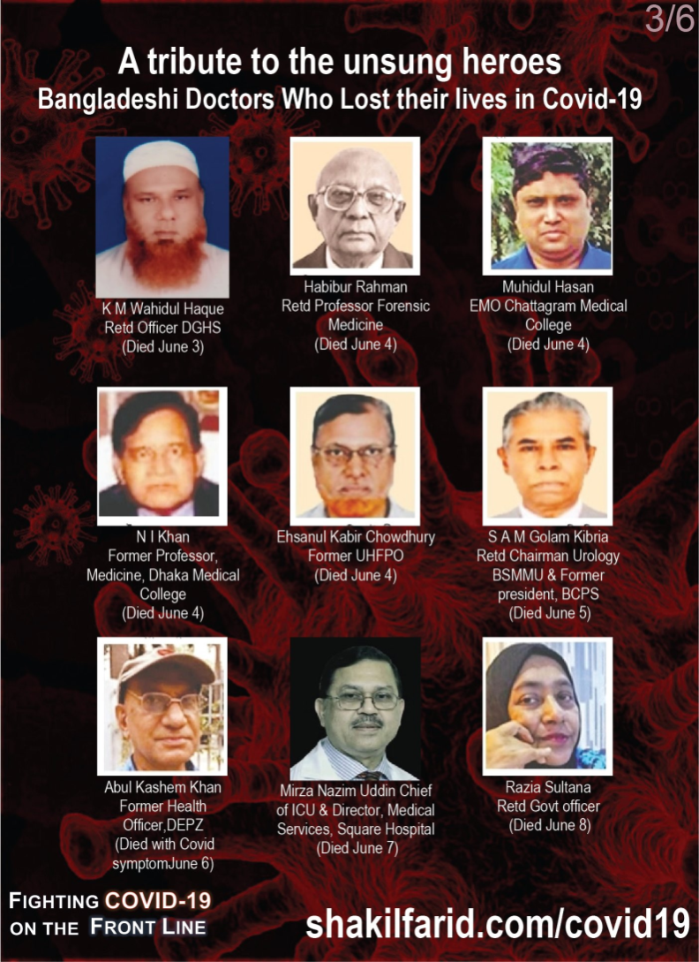


Slide 11

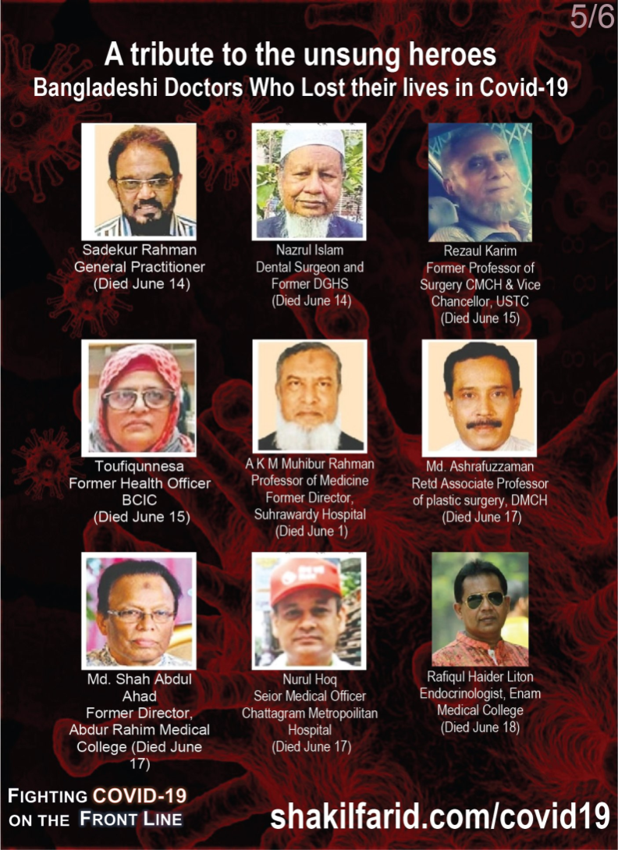

Slide 12
Global: Health workers silenced, exposed and attacked
There is currently no systematic global tracking of how many health and essential workers have died after contracting COVID-19.
However, Amnesty International has collated and analyzed a wide range of available data that shows that over 3000 health workers are known to have died after contracting COVID-19 in 79 countries around the world.
According to Amnesty International’s monitoring, the countries with the highest numbers of health worker deaths thus far include the USA (507), Russia (545), UK (540, including 262 social care workers), Brazil (351), Mexico (248), Italy (188), Egypt (111), Iran (91), Ecuador (82) and Spain (63).
Health workers reported serious shortages of personal protective equipment (PPE) in nearly all of the 63 countries and territories surveyed by Amnesty International.
Amnesty International, July 13, 2020

Slide 13
A doctor working in Mexico City told Amnesty International that doctors were spending about 12% of their monthly salaries buying their own PPE.
In addition to a global shortage of supply, trade restrictions may have aggravated this problem. In June 2020, 56 countries and two trade blocs (the European Union and the Eurasian Economic Union) had put in place measures to either ban or restrict the export of some, or all, forms of PPE or its components.
Amnesty International documented several cases where health and essential workers experienced stigma and violence because of their jobs. For example, a nurse in Mexico was reportedly drenched with chlorine while walking on the street, and in the Philippines, attackers poured bleach in the face of a hospital utility worker.
TAKE ACTION AND ADD YOUR VOICE
Let’s Protect Health and Essential Workers Everywhere in the World
Amnesty International, July 13, 2020

Slide 14
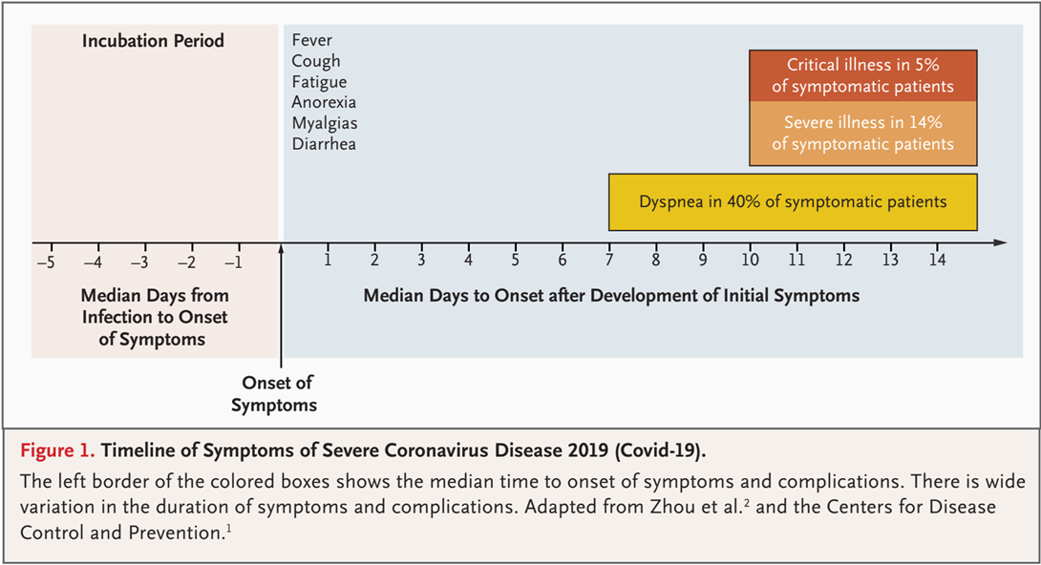
Timeline of Symptoms

Slide 15
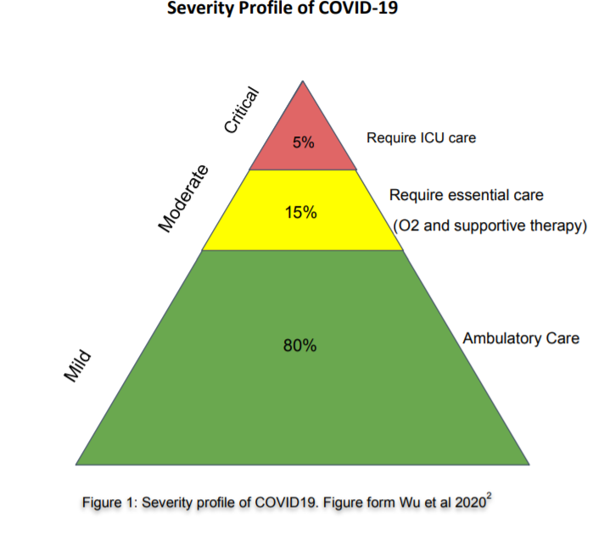

Slide 16

Case Definition
Suspect
Probable
Confirmed

Slide 17
Suspect Case
Acute respiratory illness, AND H/O travel to or residence in a country with COVID-19 disease during last 14 days.
OR,
Any acute respiratory illness AND contact with confirmed or probable COVID-19 case during last 14 days.
OR,
Severe acute respiratory illness AND no alternative diagnosis.

Slide 18
Probable Case
Suspect with inconclusive COVID-19 test
OR,
Suspect, COVID-19 test could not be done.

Slide 19
Confirmed Case
Case with laboratory confirmation of COVID-19 infection

Slide 20
Who is Contact?
No symptoms, but exposed to probable or confirmed case within 2 days before and 14 days after onset of symptoms.
Contact pattern
  - Face-to-face contact within 1 meter and for >15 minutes
  - Direct physical contact
  - Direct care of COVID-19 patient without proper PPE.

Slide 21
Clinical Presentation

Slide 22
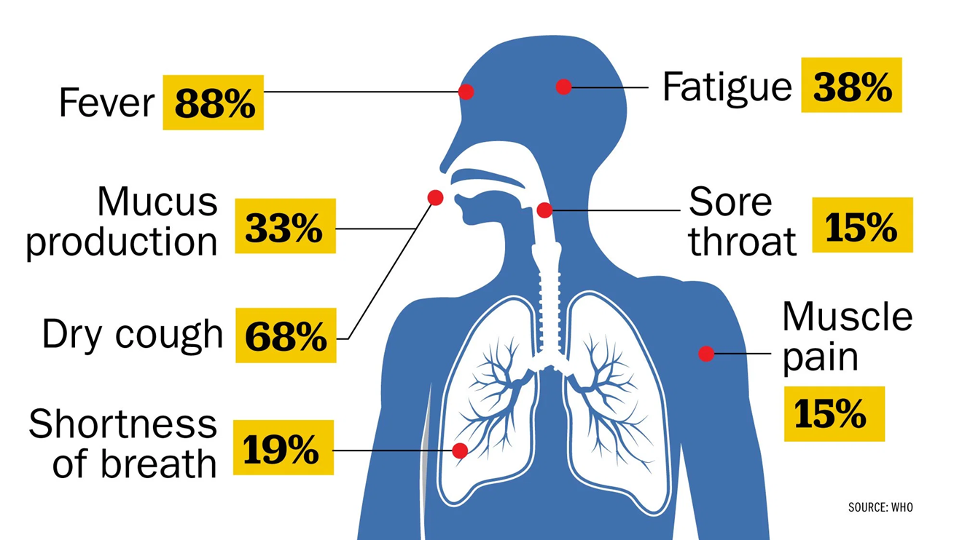
According to a study of nearly 56,000 laboratory confirmed cases cited in the WHO report, the most common symptom, experienced by 88% of confirmed patients, is a fever.

Slide 23
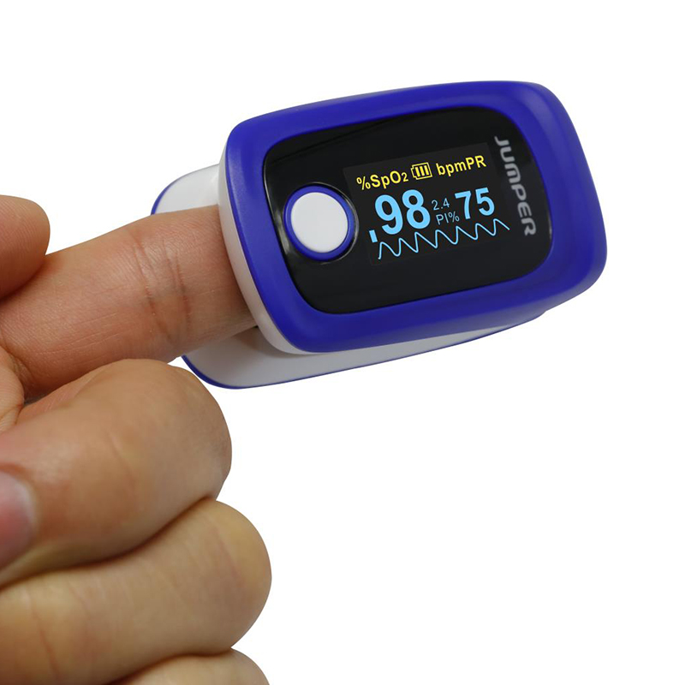
Check at Home
Patient may not feel SOB in the early stage of the disease though there is hypoxia- known as Happy Hypoxia.
Those who could not be diagnosed between 8-10 days that they have bi lateral lung infiltrates, their course of the disease and prognosis goes worst.
These group of patients proceeds to Severe /Critical.

Slide 24
Disease Manifestations
Asymptomatic (5%-80%)¹ In USA 40% ( The Mirror, 13 June)
Presymptomatic^{2,3}
  - Initially asymptomatic (1-3 days), later develops symptoms
  - Accounts for 6%-12% disease transmission
  - To prevent transmission, limiting contacts may not be enough
  - Supports social distancing, wearing surgical masks at population level.
Symptomatic
1. https://www.cebm.net/covid-19/covid-19-what-proportion-are-asymptomatic/
2. Wei WE, et al. MMWR Morb Mortal Wkly Rep. 2020 Apr 1. doi: 10.15585/mmwr.mm6914e1
3. Qian G, et al. Clin Infect Dis2020;ciaa316. doi:10.1093/cid/ciaa316

Slide 25
Clinical Features
Cough and shortness of breath or difficulty breathing plus at least 2 may indicate COVID-19 (not always applicable)
Fever Chills Repeated shaking with chills Muscle pain | Headache Sore throat New loss of taste or smell
CDC. Symptoms of Coronavirus. CDC. Available at https://www.cdc.gov/coronavirus/2019-ncov/symptoms-testing/symptoms.html. March 20, 2020; Accessed: April 28, 2020.

Slide 26
High-Risk Features
Age ≥65 years
Nursing home or long-term care facility resident
Cardiac: Heart disease with complications
Immunocompromised: Including cancer treatment
Severe obesity: BMI ≥40
High risk Pregnancy
Comorbidities: Diabetes, renal failure, liver disease, HTN
Centre for Disease Control, USA

Slide 27
Spectrum of Clinical Syndromes
Associated with COVID-19 Infection
Mild illness(ILI)
Pneumonia (Moderate)
Severe Pneumonia
Acute Respiratory Distress Syndrome
Sepsis
Septic shock

Slide 28
Severe Pneumonia
Fever or suspected RTI, plus one of :
  - Respiratory rate >30/min.
  - Severe respiratory distress; or
  - SpO₂ ≤93% on room air.

Slide 29
Acute Respiratory Distress Syndrome (ARDS)
Acute onset (within 1 week)
Bilateral opacities on chest imaging (e.g., x-ray)
Impaired oxygenation: PaO₂/FiO₂ ≤300 mmHg
If no risk factors for ARDS, acute left ventricular failure should be ruled out.
ARDS Definition Task Force, Ranieri VM, et al. JAMA. 2012 Jun 20;307(23):2526-33.

Slide 30
ARDS: When to suspect?
Critically ill patient if having…..
              - Dyspnoea, tachypnoea but
              - Chest auscultation normal.
Udobi KF, et al. Am Fam Physician. 2003 Jan 15;67(2):315-22.

Slide 31
Sepsis: Life-threatening organ dysfunction by dysregulated host response to infection
Signs of organ dysfunction:
Laboratory evidence:
Altered mental status
Difficult or fast breathing
Low oxygen saturation
Reduced urine output
Tachycardia, small volume pulse, cold extremities or low BP, skin mottling
Coagulopathy
Thrombocytopenia <50,000/cmm
Raised serum lactate
Hyperbilirubinemia

Slide 32
Septic Shock
Persisting hypotension despite volume resuscitation, requiring vasopressors to maintain MAP ≥65 mmHg and
Serum lactate level >2 mmol/L persisting after adequate fluid resuscitation. Needs Ventilator Support
Shankar-Hari M, et al., Sepsis Definitions Task Force. JAMA. 2016 Feb 23; 315(8):775-87.

Slide 33
ICU and Ventilator Mortality Among Critically Ill Adults With Corona virus Disease 2019- study report
217 critically ill patients (March 6 to April 17), Atlanta, Georgia
Median Age 64(54-73) 1/4th cases were more than age 75 years
Commonest co-morbid conditions HTN(61.7%),DM (46.55%)
Median SOFA score was 7, Initial score > 11 (90%) mortality
Median D-dimer was 1731ng/ml (< 300)
Median CRP was 190 (<10)
75% patients received invasive ventilation

Slide 34
65% patients received Vasopressor for combating shock and 30% got RRT, 1.8% received ECMO
ICU mortality was 40%, Hospital mortality was 35.7%.
Significant association of mortality: Older age, Lower BMI, CKD, higher (SOFA score, CRP, D-dimer)
Needs mechanical ventilation ,Vasopressor and RRT
No difference of survival between patients received or not received Ramdesivir

Slide 35
Early intubation and standard lung protective ventilation strategies is useful.
2/3rd cases can be saved even those who require invasive mechanical ventilation.
ICU and Ventilator Mortality Among Critically Ill Adults With Coronavirus Disease 2019. M W. Adelman, S Arno, S C. Auld, T Barnes, W Bender, J M. Blum, G Budhrani, S Busby et al ; Crit Care Med. 2020 May 26

Slide 36
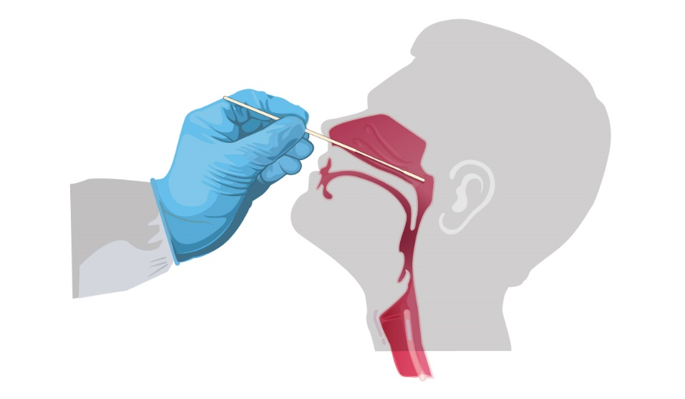
Investigations

Slide 37
Real-time RT-PCR Test for SARS-CoV-2
All suspects should have RT-PCR
Gold standard
High specificity, low sensitivity (65-95%)
Specimen:
  Upper airway specimens: Nasopharyngeal swab (first choice), oropharyngeal swab
  Lower airway specimens: Bronchoalveolar lavage, tracheal aspirate, pleural fluid, lung biopsy, sputum

Slide 38
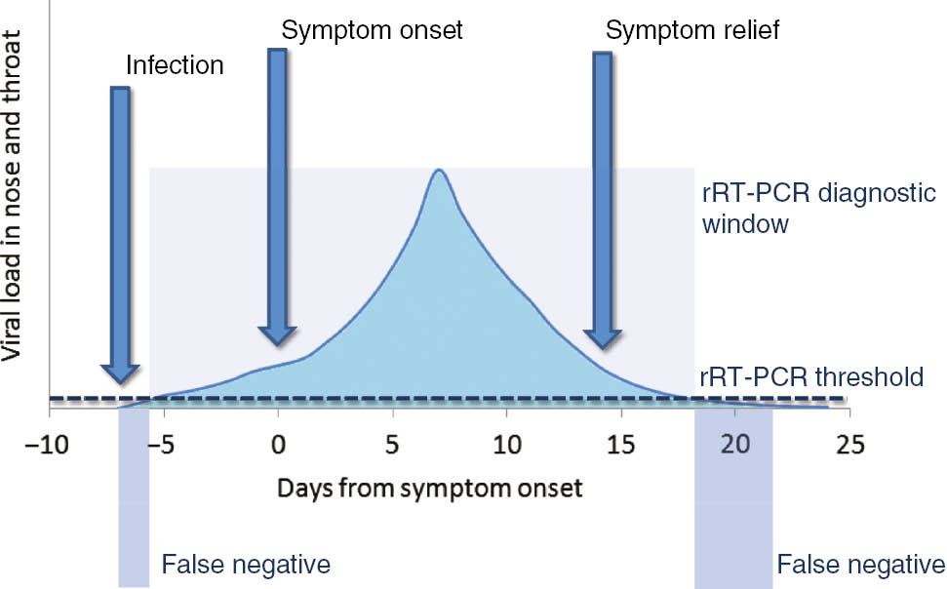
RT-PCR for SARS-CoV-2
Correspondence between viral load,
disease progression and RT-PCR
RT-PCR in 56 confirmed COVID- 19
patients in China
Week | Positivity
1 | 100%
2 | 89.3%
3 | 66.1%
4 | 32.1%
5 | 5.4%
6 | 0%
Xiao AT et al. Clin Infect Dis. 2020 Apr 19. pii: ciaa460. doi: 10.1093/cid/ciaa460.
Lippi G, et al. Clin Chem Lab Med. 2020 Mar 16. pii: /j/cclm.ahead-of-print/cclm-2020-0285/cclm-2020-0285.xml.

Slide 39
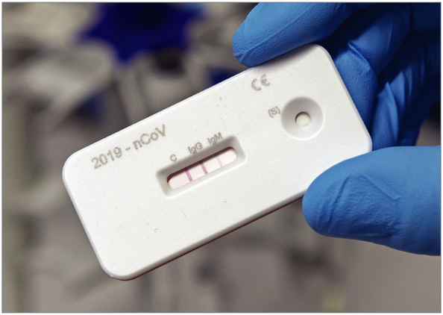
Serological Tests for SARS-CoV-2
Still evolving
Low sensitivity, good specificity
Still not recommended by WHO
CDC, USA has granted EUA
May be important for sero-surveillance
Gonoshasthaya's Rapid Dot Blot testing kit is under trial by ICDDR,B

Slide 40
Other Investigations
Blood tests:
  CBC: Lymphopenia;
  N:L >3.5 bad prognosis
  CRP: Raised
  Serum procalcitonin: Normal
  Serum ferritin: Raised
  Serum LDH: Mildly raised
  Serum D-dimer: Raised
Imaging: Atypical pneumonia
          Chest x-ray
          HRCT scan of chest
          USG of chest
Serological tests for SARS-CoV-2
          Still evolving
Viral culture

Slide 41
CT Scan of Chest
Should not be relied upon for diagnosis and screening
High sensitivity (94%) but low specificity (37%)
Commonest: Ground-glass opacities -- bilateral, subpleural, peripheral
Others:
  Crazy paving appearance (ground-glass opacities plus inter-/intra-lobular septal thickening)
  Consolidation
  Vascular dilatation
  Traction Bronchiectasis
  Subpleural bands and architectural distortion
https://radiologyassistant.nl/chest/lk-jg-1

Slide 42
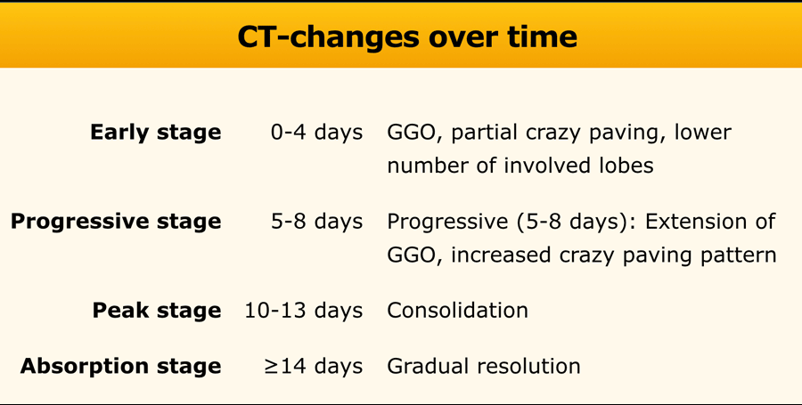
https://radiologyassistant.nl/chest/lk-jg-1

Slide 43
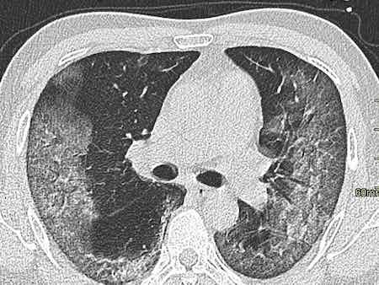
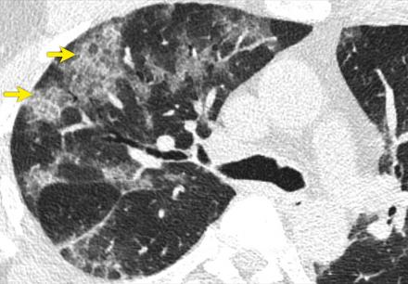
CT scan of chest in COVID- 19
Ground glass opacity
Crazy paving
https://radiologyassistant.nl/chest/lk-jg-1

Slide 44
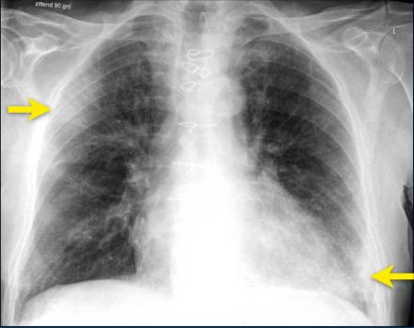
Chest x-ray
Typically, first-line imaging modality
Less sensitive than CT scan of chest
Commonest: Consolidation
Less common: Ground glass opacity
Bilateral, peripheral, lower zone predominant
Pleural effusion rare.
Ground-glass opacification and consolidation in
right upper lobe and left lower lobe (arrows).
https://radiologyassistant.nl/chest/lk-jg-1

Slide 45
Chest x-ray in COVID- 19
Bilateral pneumonia
ARDS
National Guidelines on Clinical Management of Coronavirus Disease 2019(Covid-19), Version 5.9 April 2020, Government of the People's Republic of Bangladesh.

Slide 46
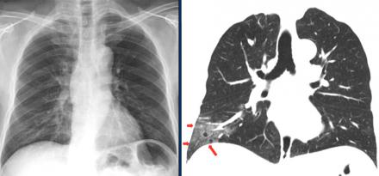
CXR vs. CT scan of Chest
Ground glass opacities in right lower lobe on CT (red arrows) are not
visible on chest radiograph, which was taken 1 hour prior to CT-study.
https://radiologyassistant.nl/chest/lk-jg-1

Slide 47
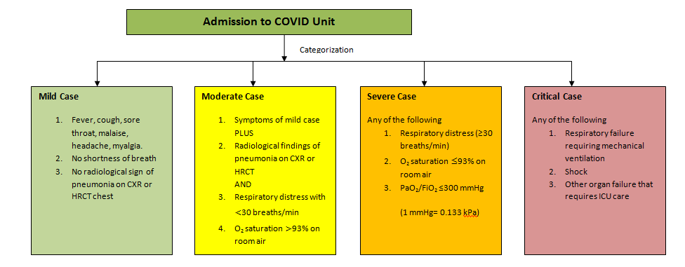
Admission to COVID Unit

Slide 48
Management

Slide 49
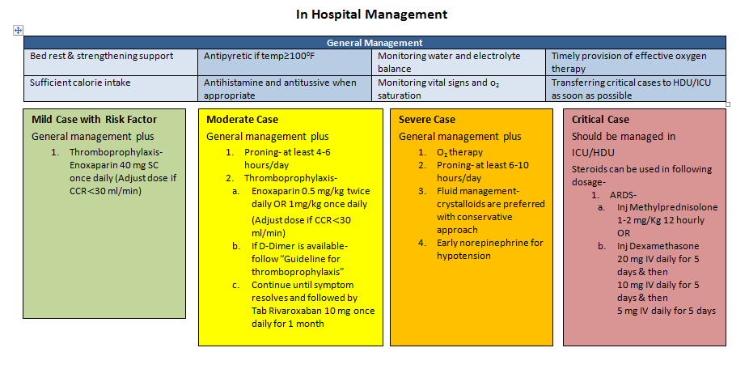
In Hospital Management

Slide 50
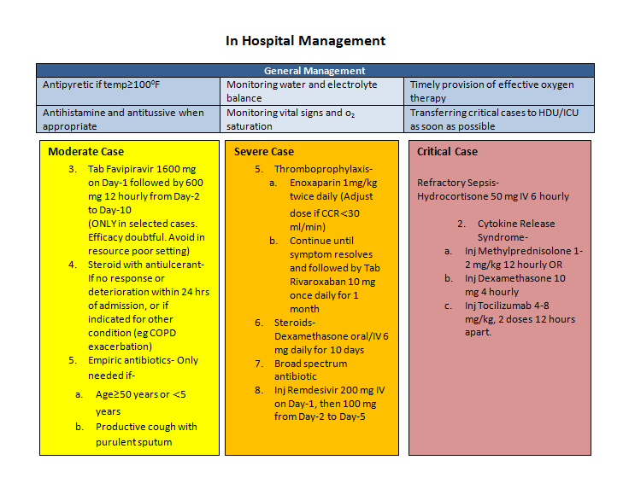
In Hospital Management

Slide 51
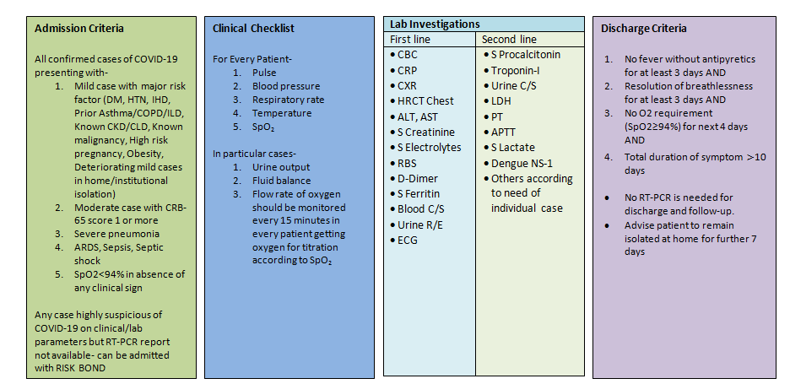

Slide 53
No specific treatment
Management mostly symptomatic & supportive

Slide 54
Clinical Criteria for Case Management
Stage of illness | Definition
Mild | Influenza like illness (ILI)
Moderate | Pneumonia (CRB 65 score 0)
Severe | Severe pneumonia, sepsis
Critical | ARDS, septic shock

Slide 55
Where to Manage?
Stage of Illness | Definition | Place of Care
Asymptomatic | No symptoms | Home, ?Tele- medicine
Mild | Influenza like illness (ILI) | Home
Moderate | Pneumonia (CRB 65 score 0) | Home
Severe | Severe pneumonia, sepsis | Hospital, preferably, HDU
Critical | ARDS, septic shock | Hospital, preferably, ICU

Slide 56
Mild cases (Influenza-like illness)
Self-isolation at home (if not possible, institutional isolation)
Symptomatic treatment: Paracetamol, antihistamine
Azithromycin-500 mg once on D1, then 250 mg on D2 to D5.

Slide 57
Self-home isolation for 14 days after clinical recovery
When to seek hospital care?
              Respiratory distress
              Worsening cough and fever
              Altered mental status
              Extreme lethargy

Slide 58
Moderate Cases (Pneumonia)
Treatment as for mild cases
PLUS
Oral antibiotics as for uncomplicated community acquired pneumonia
Favipiravir 1600 mg stat, 600 mg bd 7-10 days. Efficacy doubtful?
Thromboprophylaxis with LMW heparin ( 1 mg/kg BW)
DOAC – Rivaroxavan 10 – 20 mg/ day 2 -4 weeks

Slide 59
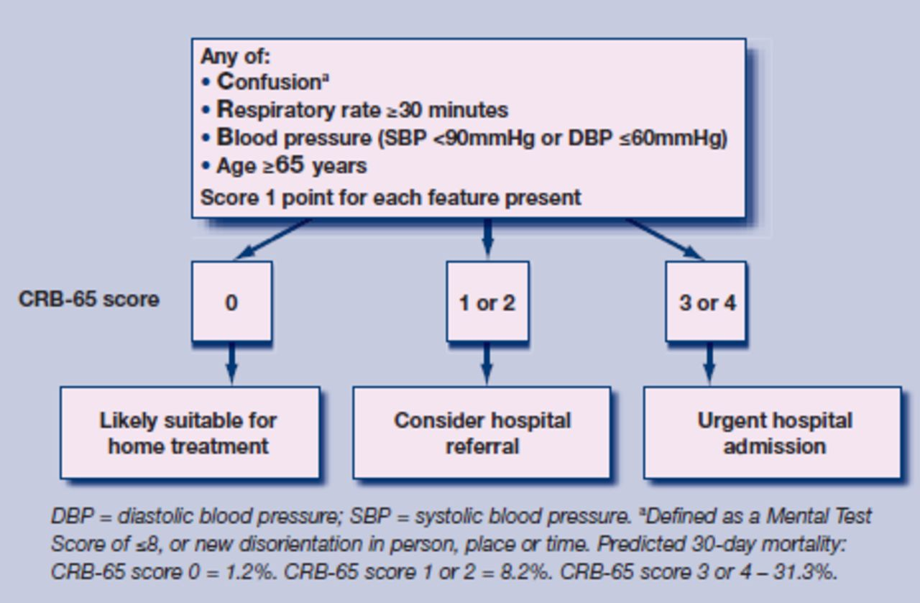
CRB 65 Scoring System

Slide 60
Severe Cases (Severe Pneumonia, Sepsis)
Supplemental oxygen:
        If SpO₂ <94%; respiratory rate >30/minute; shock
        Oxygen at 5 litres/min, titrated to target SpO₂ >94%
Empirical antibiotics Injectables
Inj.. Ramdisivir 200 mgstat, 100 mg daily -5 days
Thromboprophylaxis with LMW heparin ( 1 mg/kg BW bd)
Management of co-morbid conditions

Slide 61
Critical Cases (ARDS, Septic shock)
Ventilation:
  Immediate supplemental oxygen, if SpO₂ <94%; high flow nasal canula preferable
  Mechanical ventilation in prone position
Haemodynamic support: Target MAP of 60-65 mmHg.
  Conservative fluid strategy, crystalloids preferable
  Inotropes: norepinephrine (first line), vasopressin (second line)
Empirical antibiotics
Steroid, if septic shock, ARDS ( Inj. Dexamethasone 10 -20 mg/d)
Thromboprophylaxis with LMW heparin ( Full dose- 14 days)

Slide 62
COVID patient’s Oxygen Delivery Algorithm
Aim: SpO2 90-96%%
Device: Nasal prongs/ Face mask/ NRB Mask
Starts oxygen 2-6 l/min through nasal prongs
Asses response for 10-15min to keep Spo2 >90%
If increasing respiratory distress
or SpO2 < 90% (88% in COPD)
Starts oxygen 6-10 l/min through Face mask
Asses response for 10-15min to keep Spo2 >90%

Slide 63
If increasing respiratory distress or SpO2 <90% (<88% in COPD)
Start Proning breathing along with supplement oxygen 10-15 l/min through Face mask/NRB mask
Asses response for 10-15min to keep Spo2 >90%
If still increasing respiratory distress
or SpO2 <90% (<88% in COPD)
or patient is exhausted HFNC is urgently needed ( 40 -50L) /minute, if all these fail only then
Refer the patient to ICU for Ventilator assistance

Slide 64
Available Treatment
Remdesivir: FDA approved (available in Bangladesh)
Favipiravir: Available ( ? doubtful efficacy)
Convalescent plasma ( In use)
Tocilizumab ( specific indication of use) CSS

Slide 65

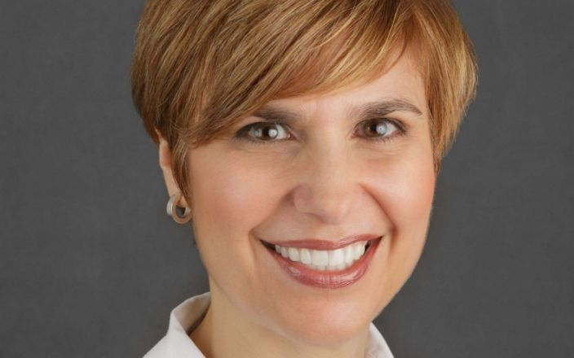
COVID- 19 and Mental Health
A medical worker is seen sitting in the East Village of China during the coronavirus pandemic
Dr. Lorna M. Breen, medical director at NewYork-Presbyterian Allen Hospital, committed suicide.

Slide 66
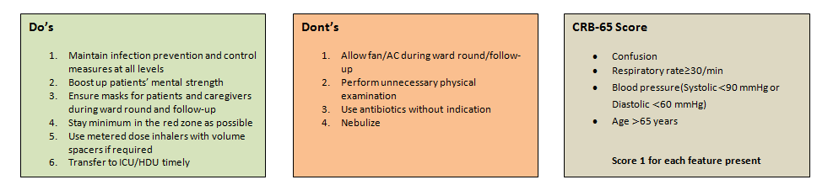

Slide 67
Take-Home Message
An RNA virus disease, mainly spread by respiratory droplets
Majority experiences mild to moderate respiratory illness
RT-PCR is the gold standard test
Management is symptomatic and supportive
Thromboprophylaxis for all hospitalized COVID- 19 patients
Remdisivir has EUA by FDA
Home management is for asymptomatic, mild and moderate diseases
Hospital management is indicated for severe and critical diseases
Vaccines are in up to phase 2 trial
Prognosis appears better than SARS, MERS, and Ebola.

Slide 68


Slide 69
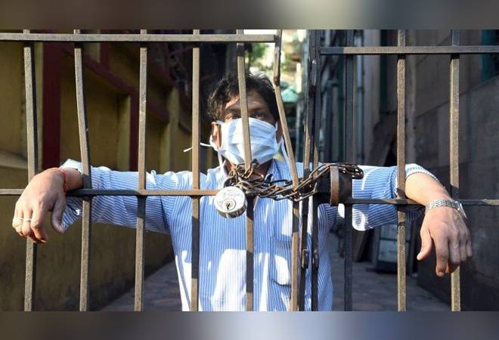

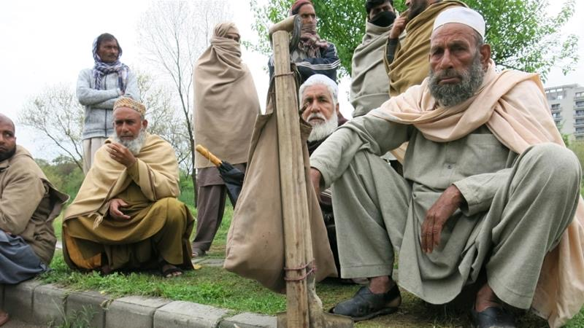

Thank you

